Slide 1
Exploring Customer Behavior Through Database Analysis : SQL Case Study
Data Driven Insights from Customer Behavior data
Presented by Pavan kulkarni
Batch number CX-127feb

Slide 2
Introduction
This report presents an SQL-based case study aimed at understanding customer behavior in the context of food ordering. Using a structured database containing customer orders—specifically the date of order, items ordered, and the amount spent—this project applies SQL techniques to extract valuable insights. The goal is to analyze trends in customer preferences, spending behavior, and order frequency to inform business strategies in the food and beverage sector.

Slide 3
Methodologies
SQL used to extract, filter and analyze data
SQL commands used such as
Aggregation function like Avg(),Sum(),Count(),
Joins across multiple tables(employees ,departments , Jobs, Region, Location)
Filters:- Where ,Having , Group by
Windows:- function Rank , Partition by, Order by
Subqueries and CTEs

Slide 4
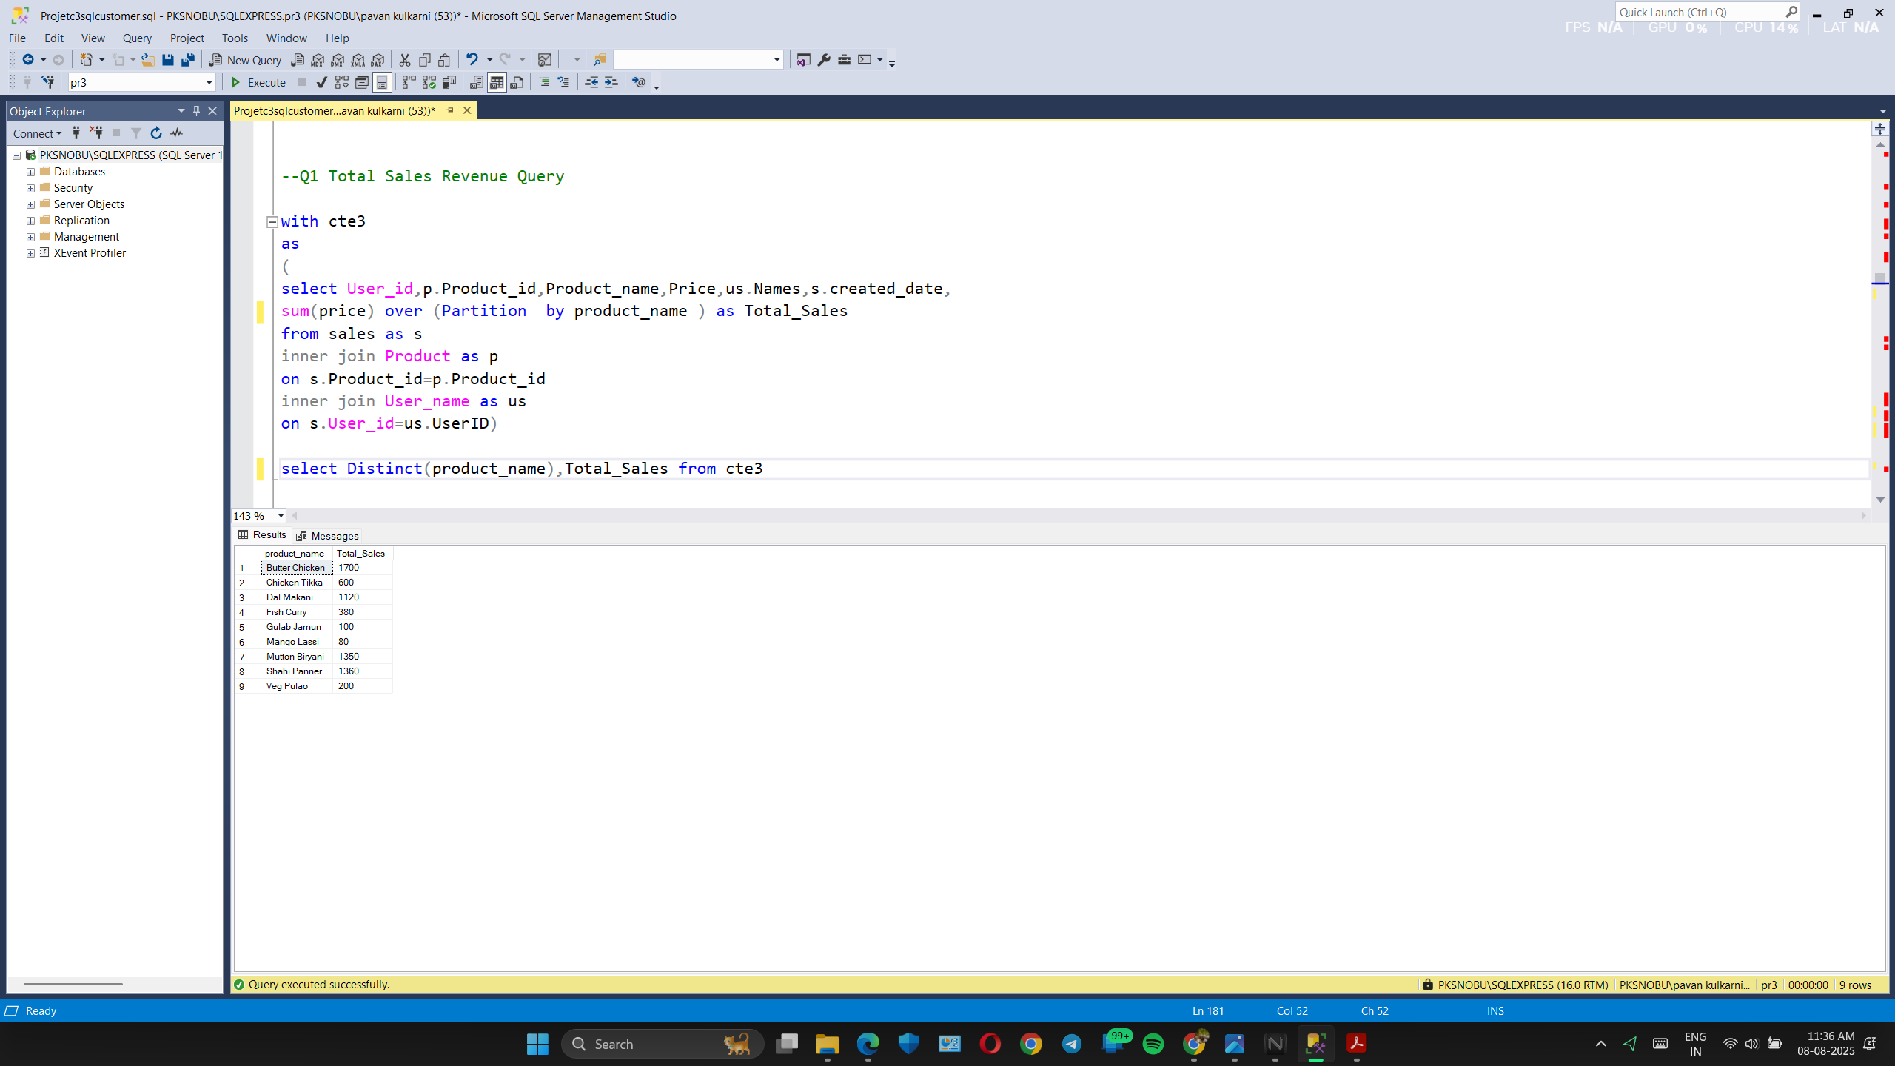
Total Sales Revenue by each product

Slide 5
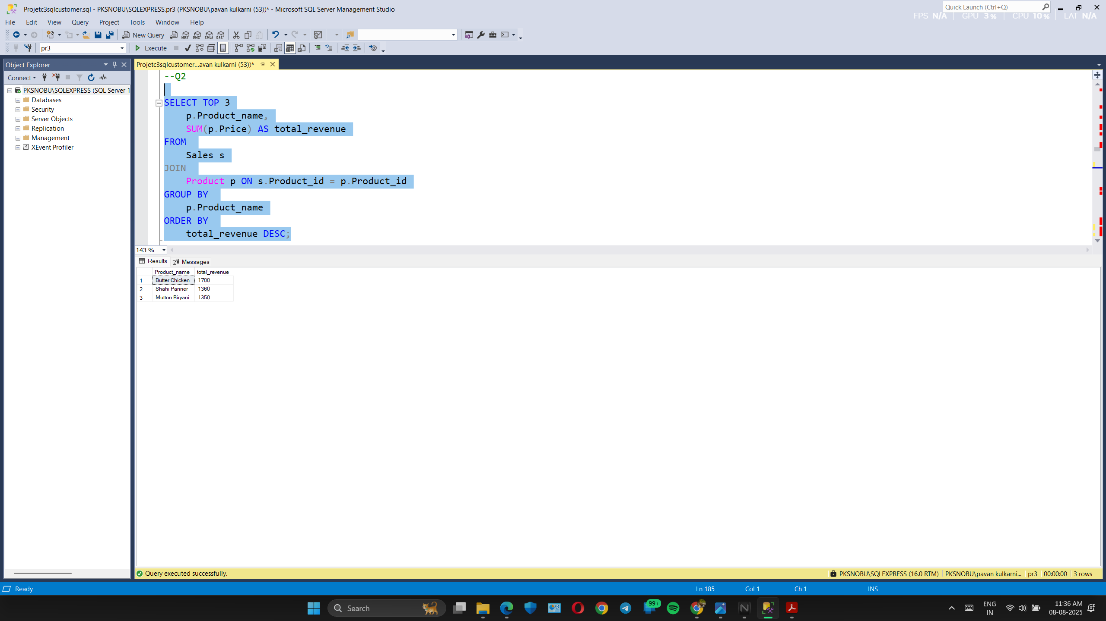
TOP 3 products of sales revenue

Slide 6
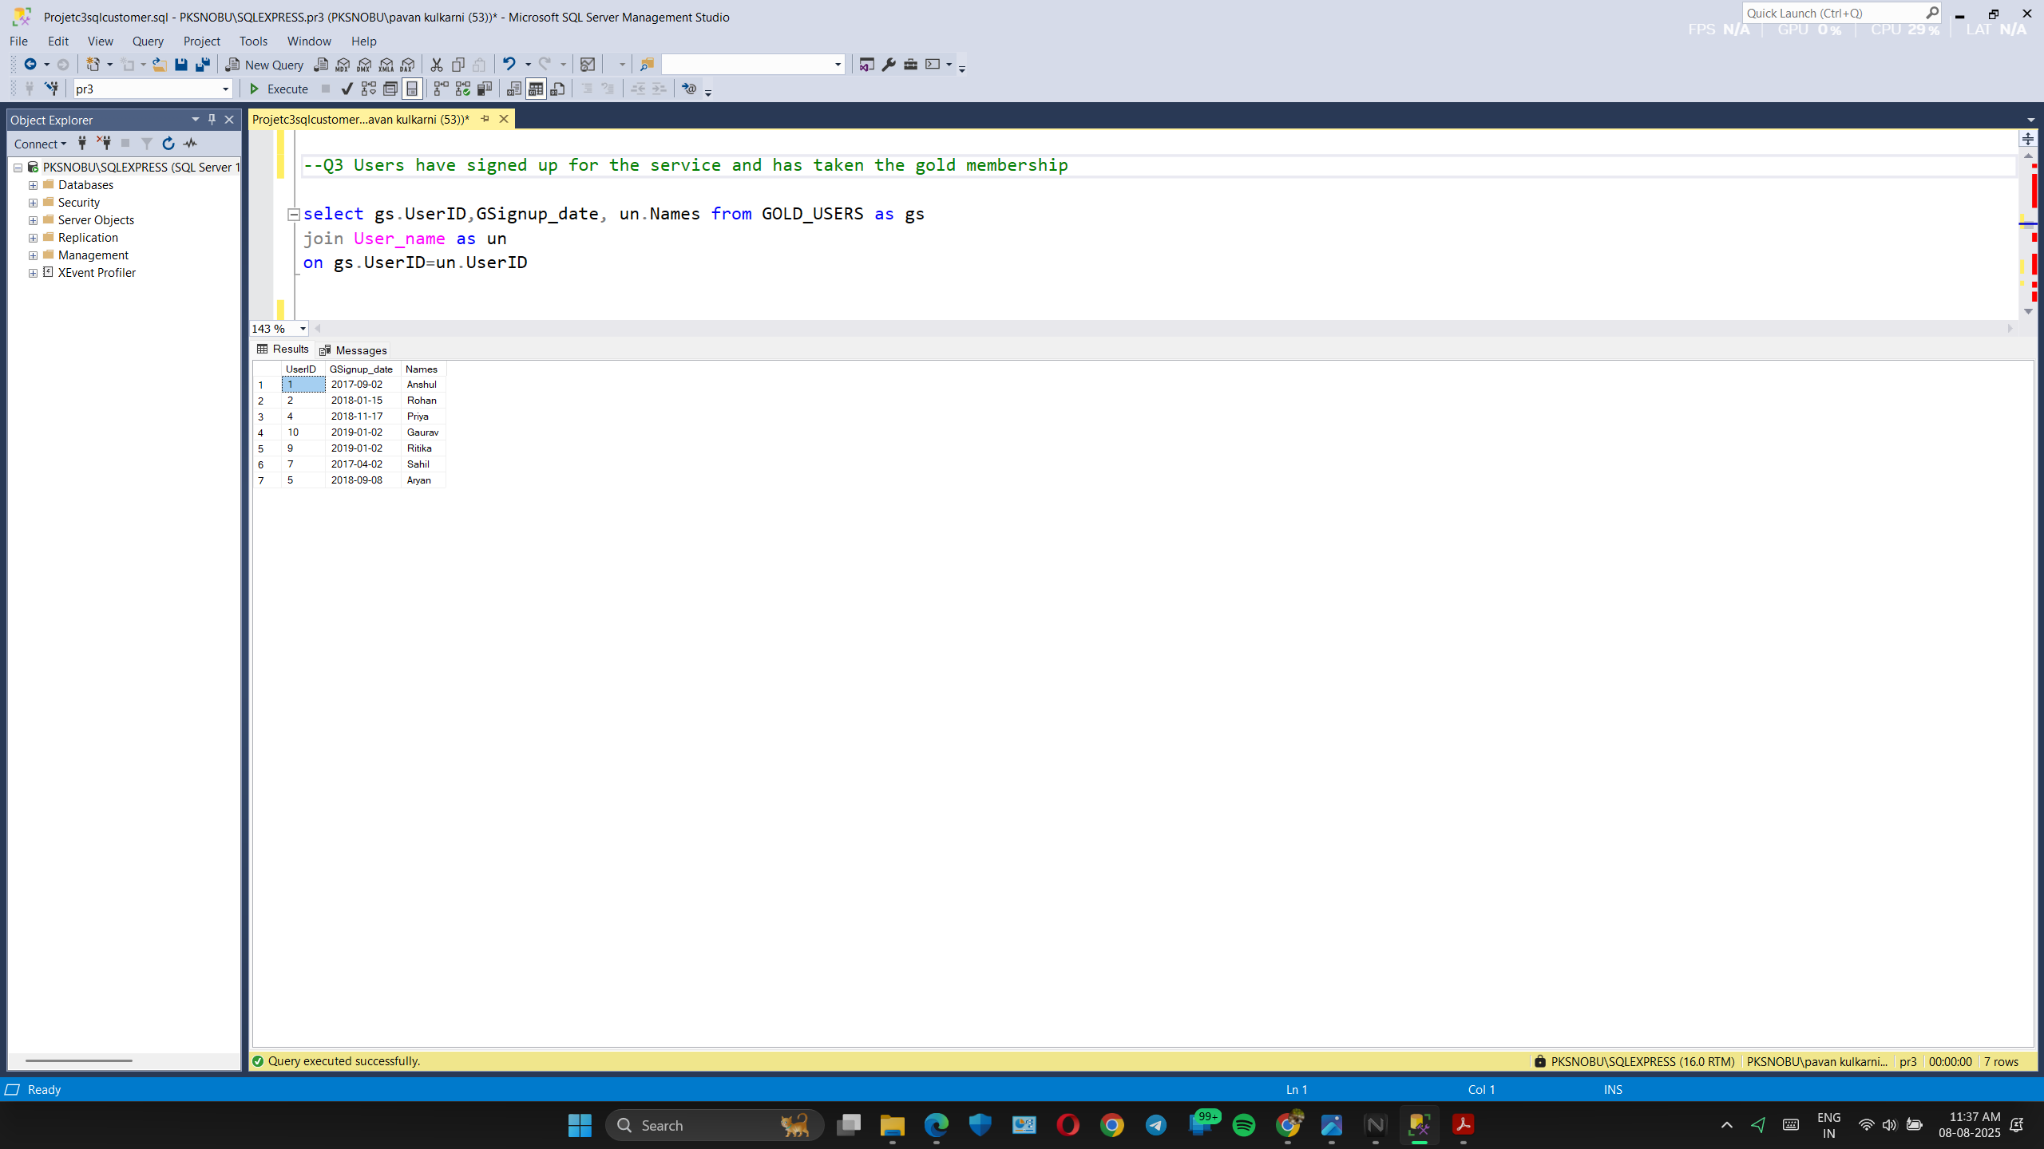
User’s name and ID Who Joined Gold Membership

Slide 7
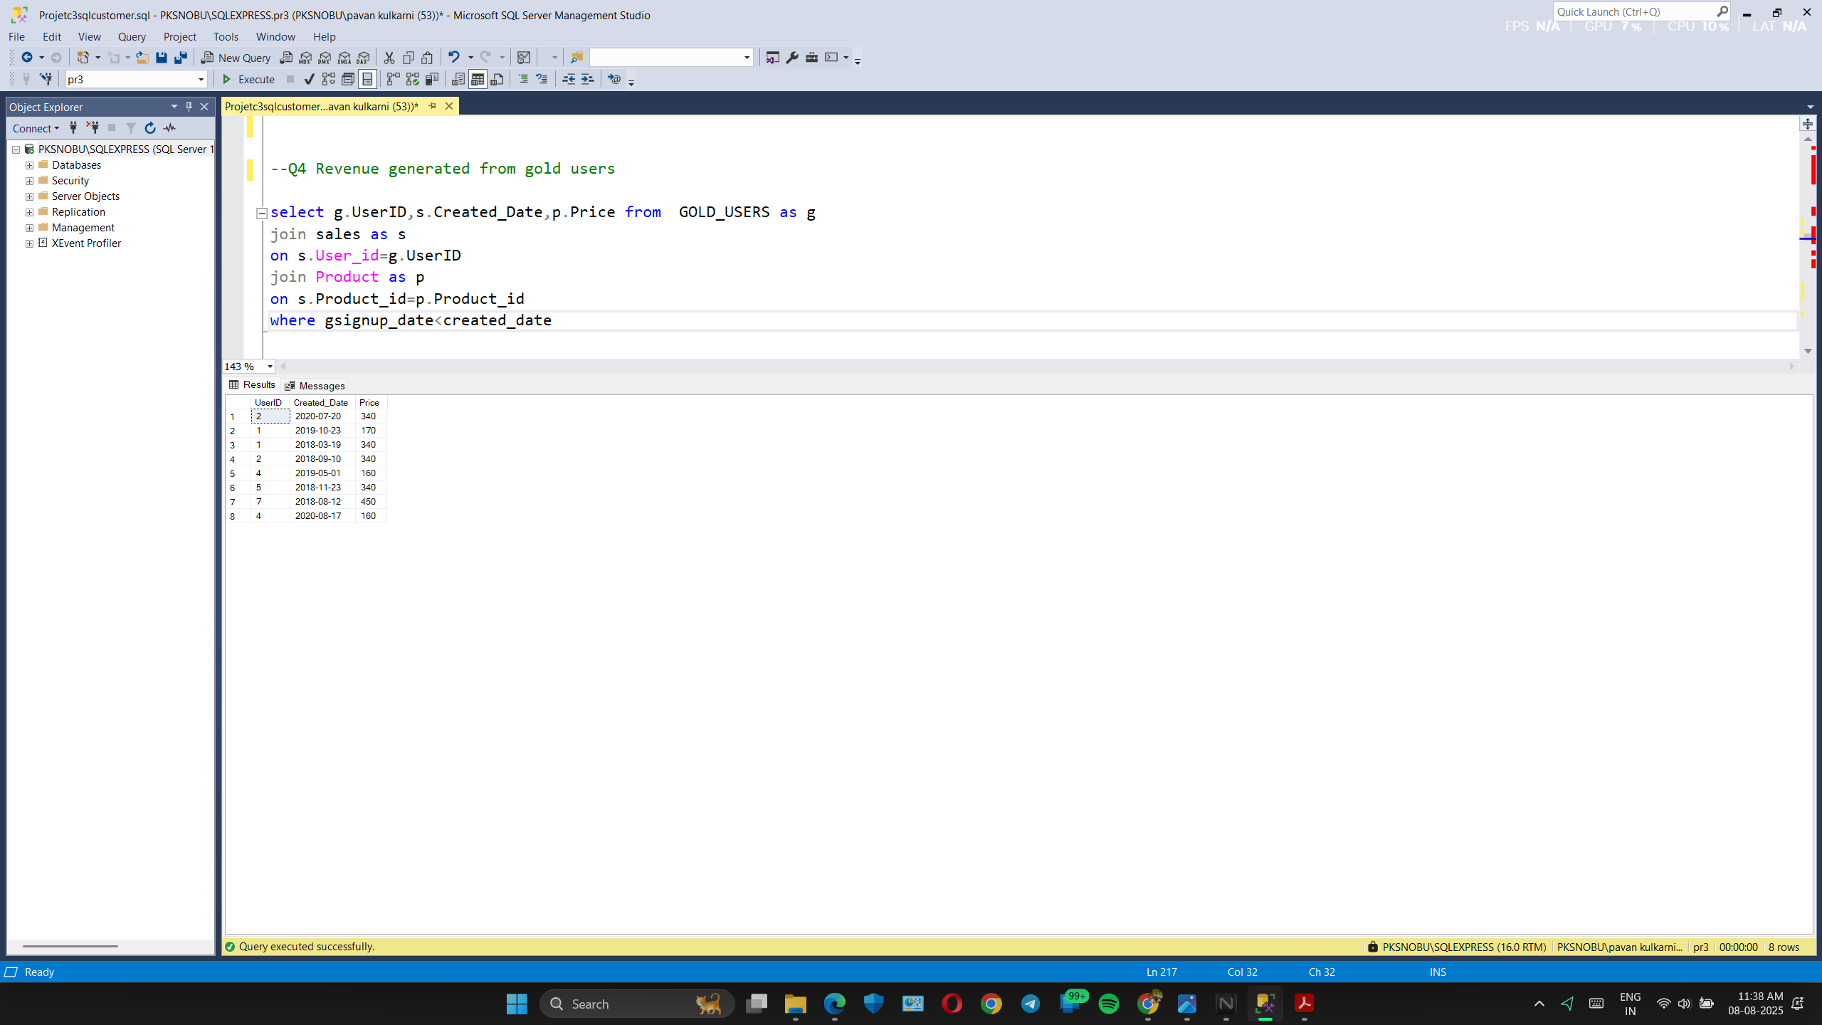
Revenue Generated by Gold Users

Slide 8
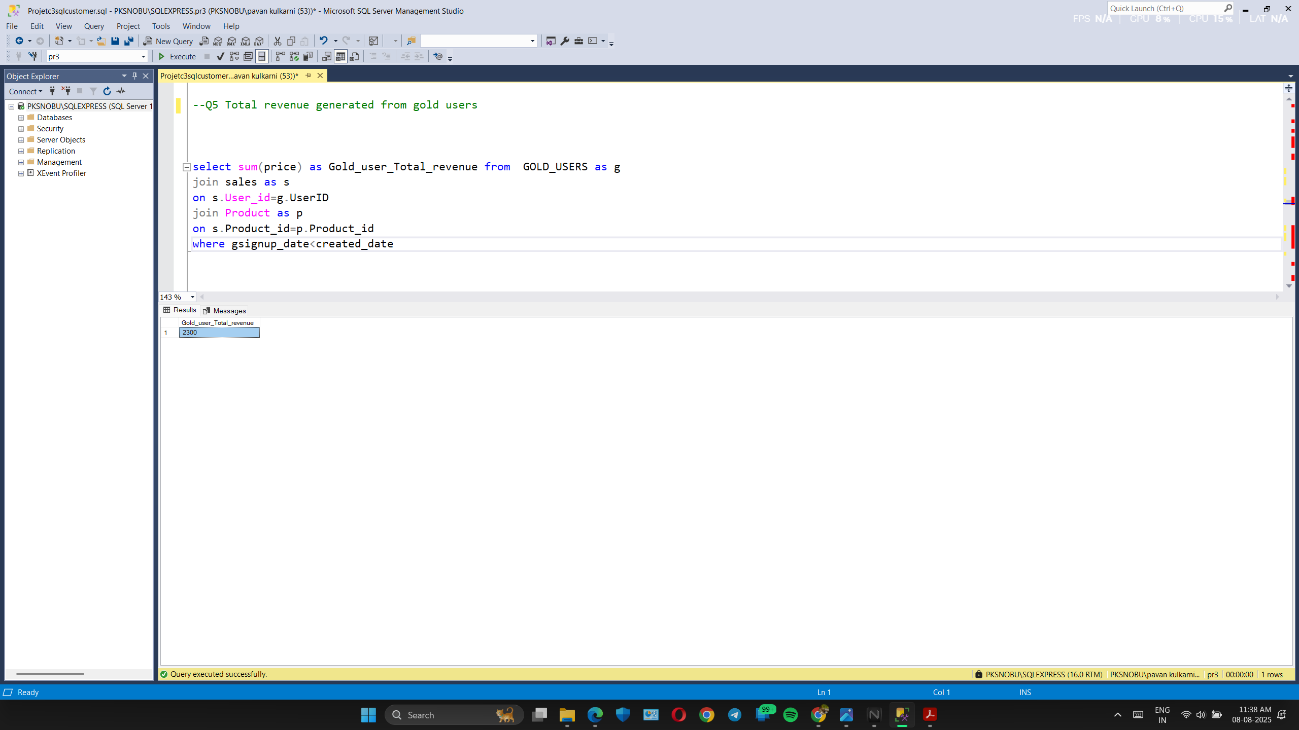
Total Revenue by Gold Users

Slide 9
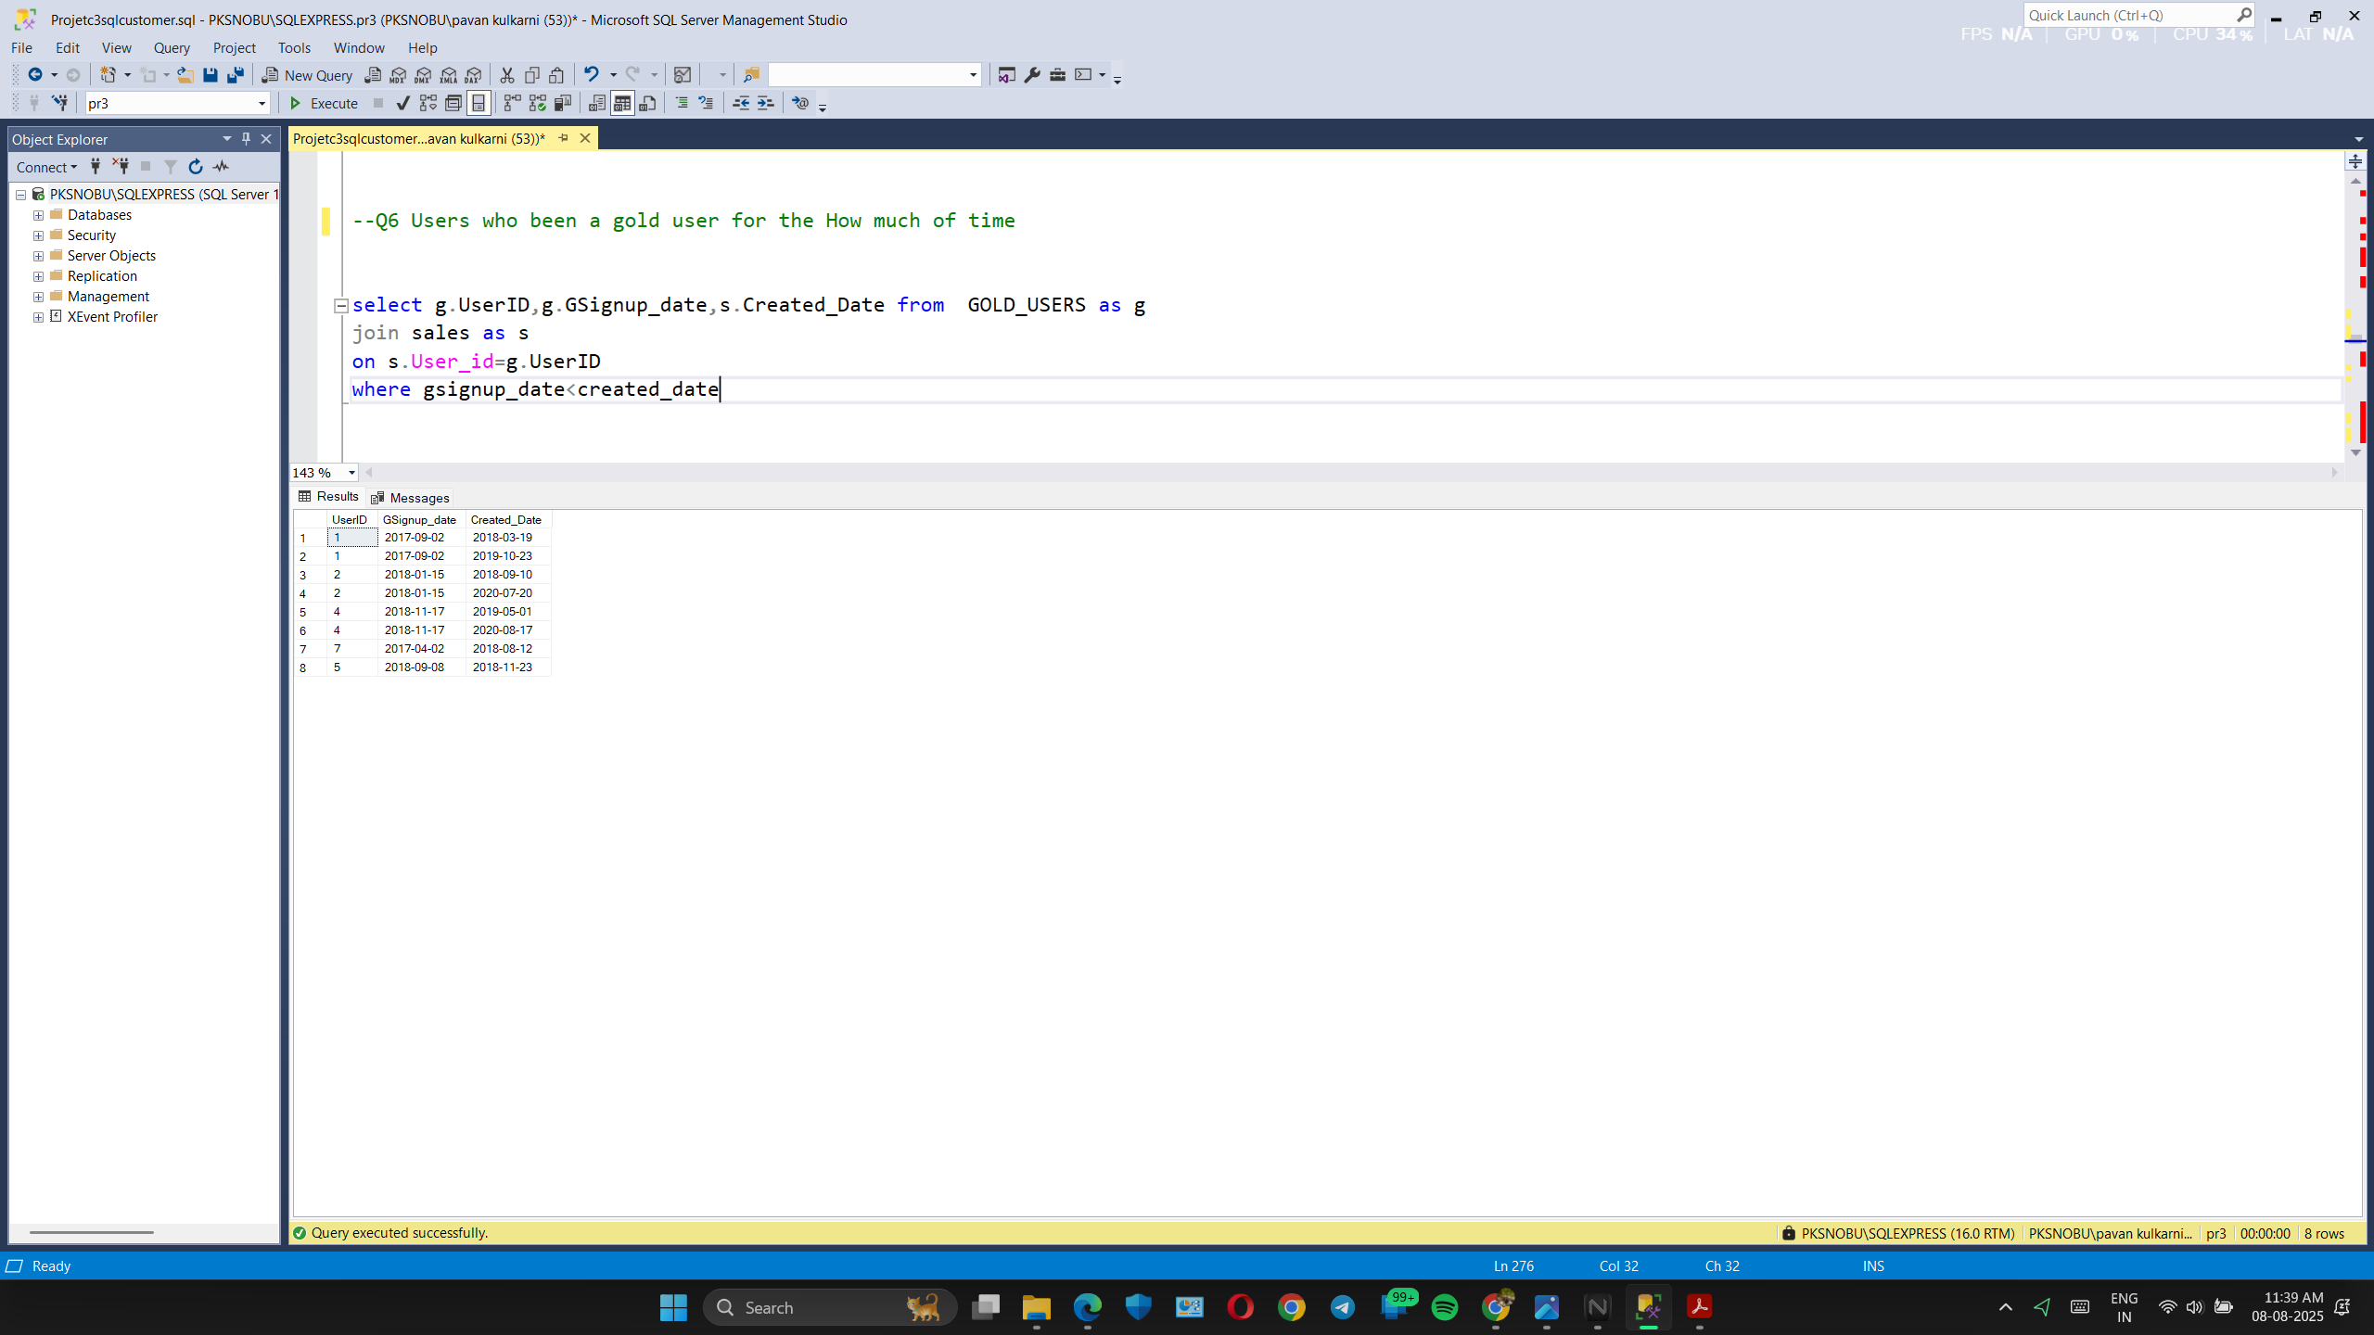
Duration of users being a Gold Member

Slide 10
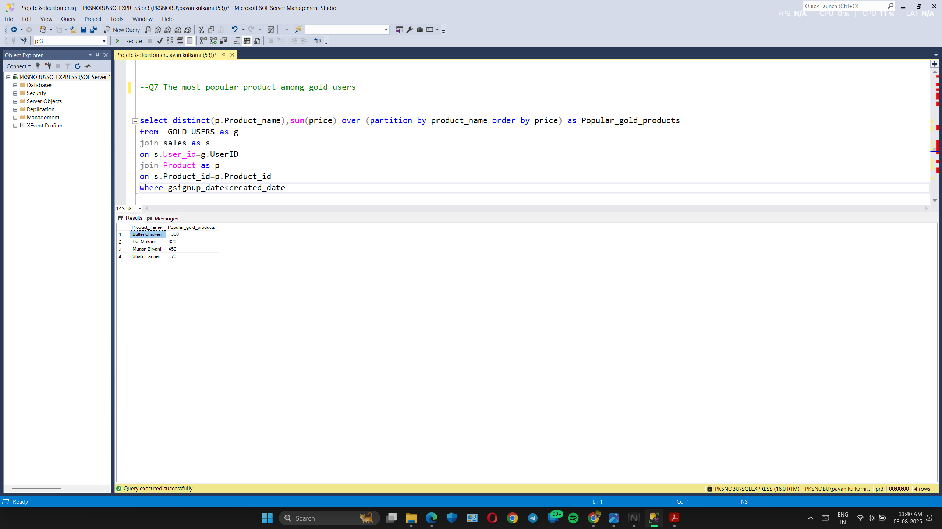
The most popular product among gold users

Slide 11
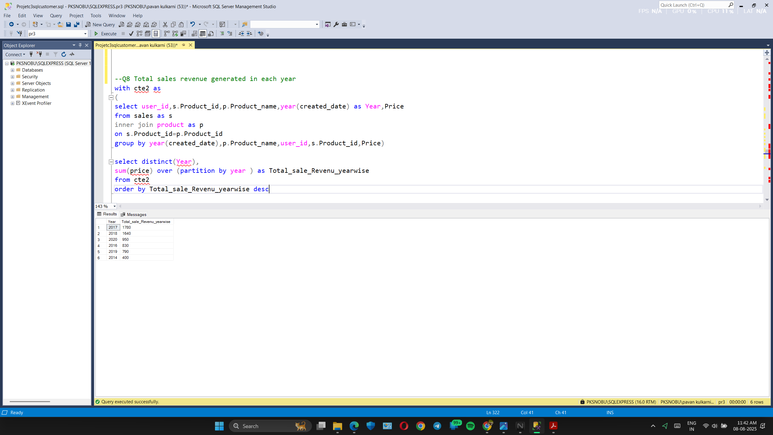
Total revenue generated year wise

Slide 12
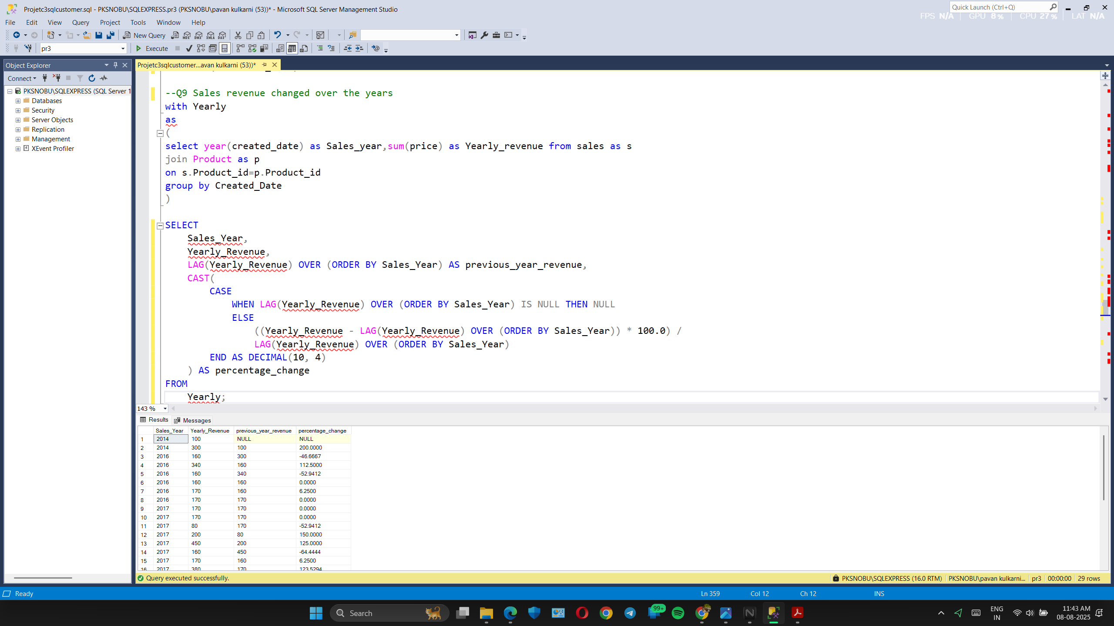
Sales revenue percentage change over years

Slide 13
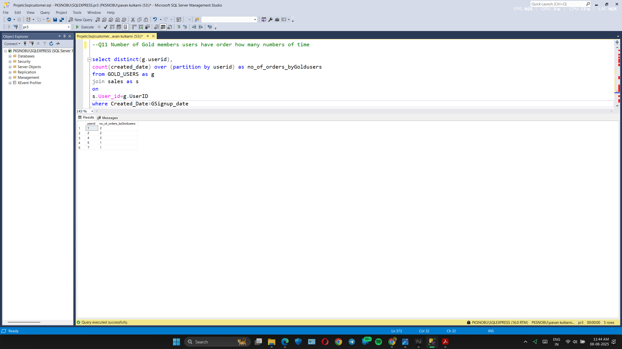
Number of orders by each Gold users

Slide 14
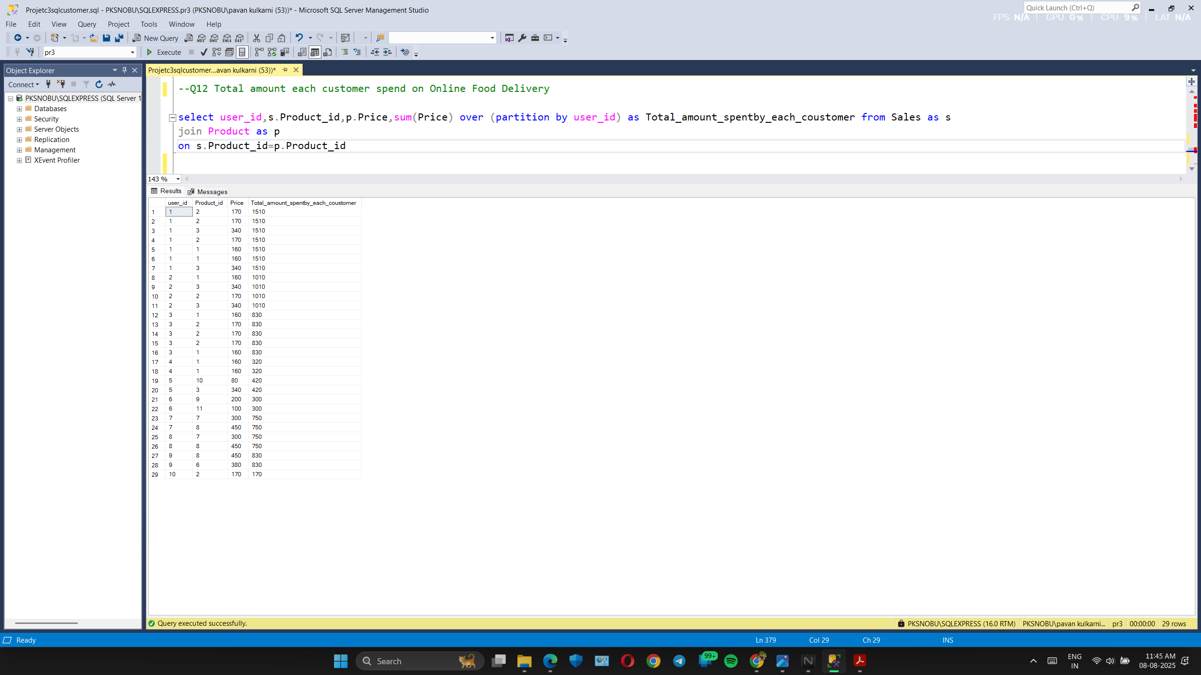
Total amount spend by each customer

Slide 15
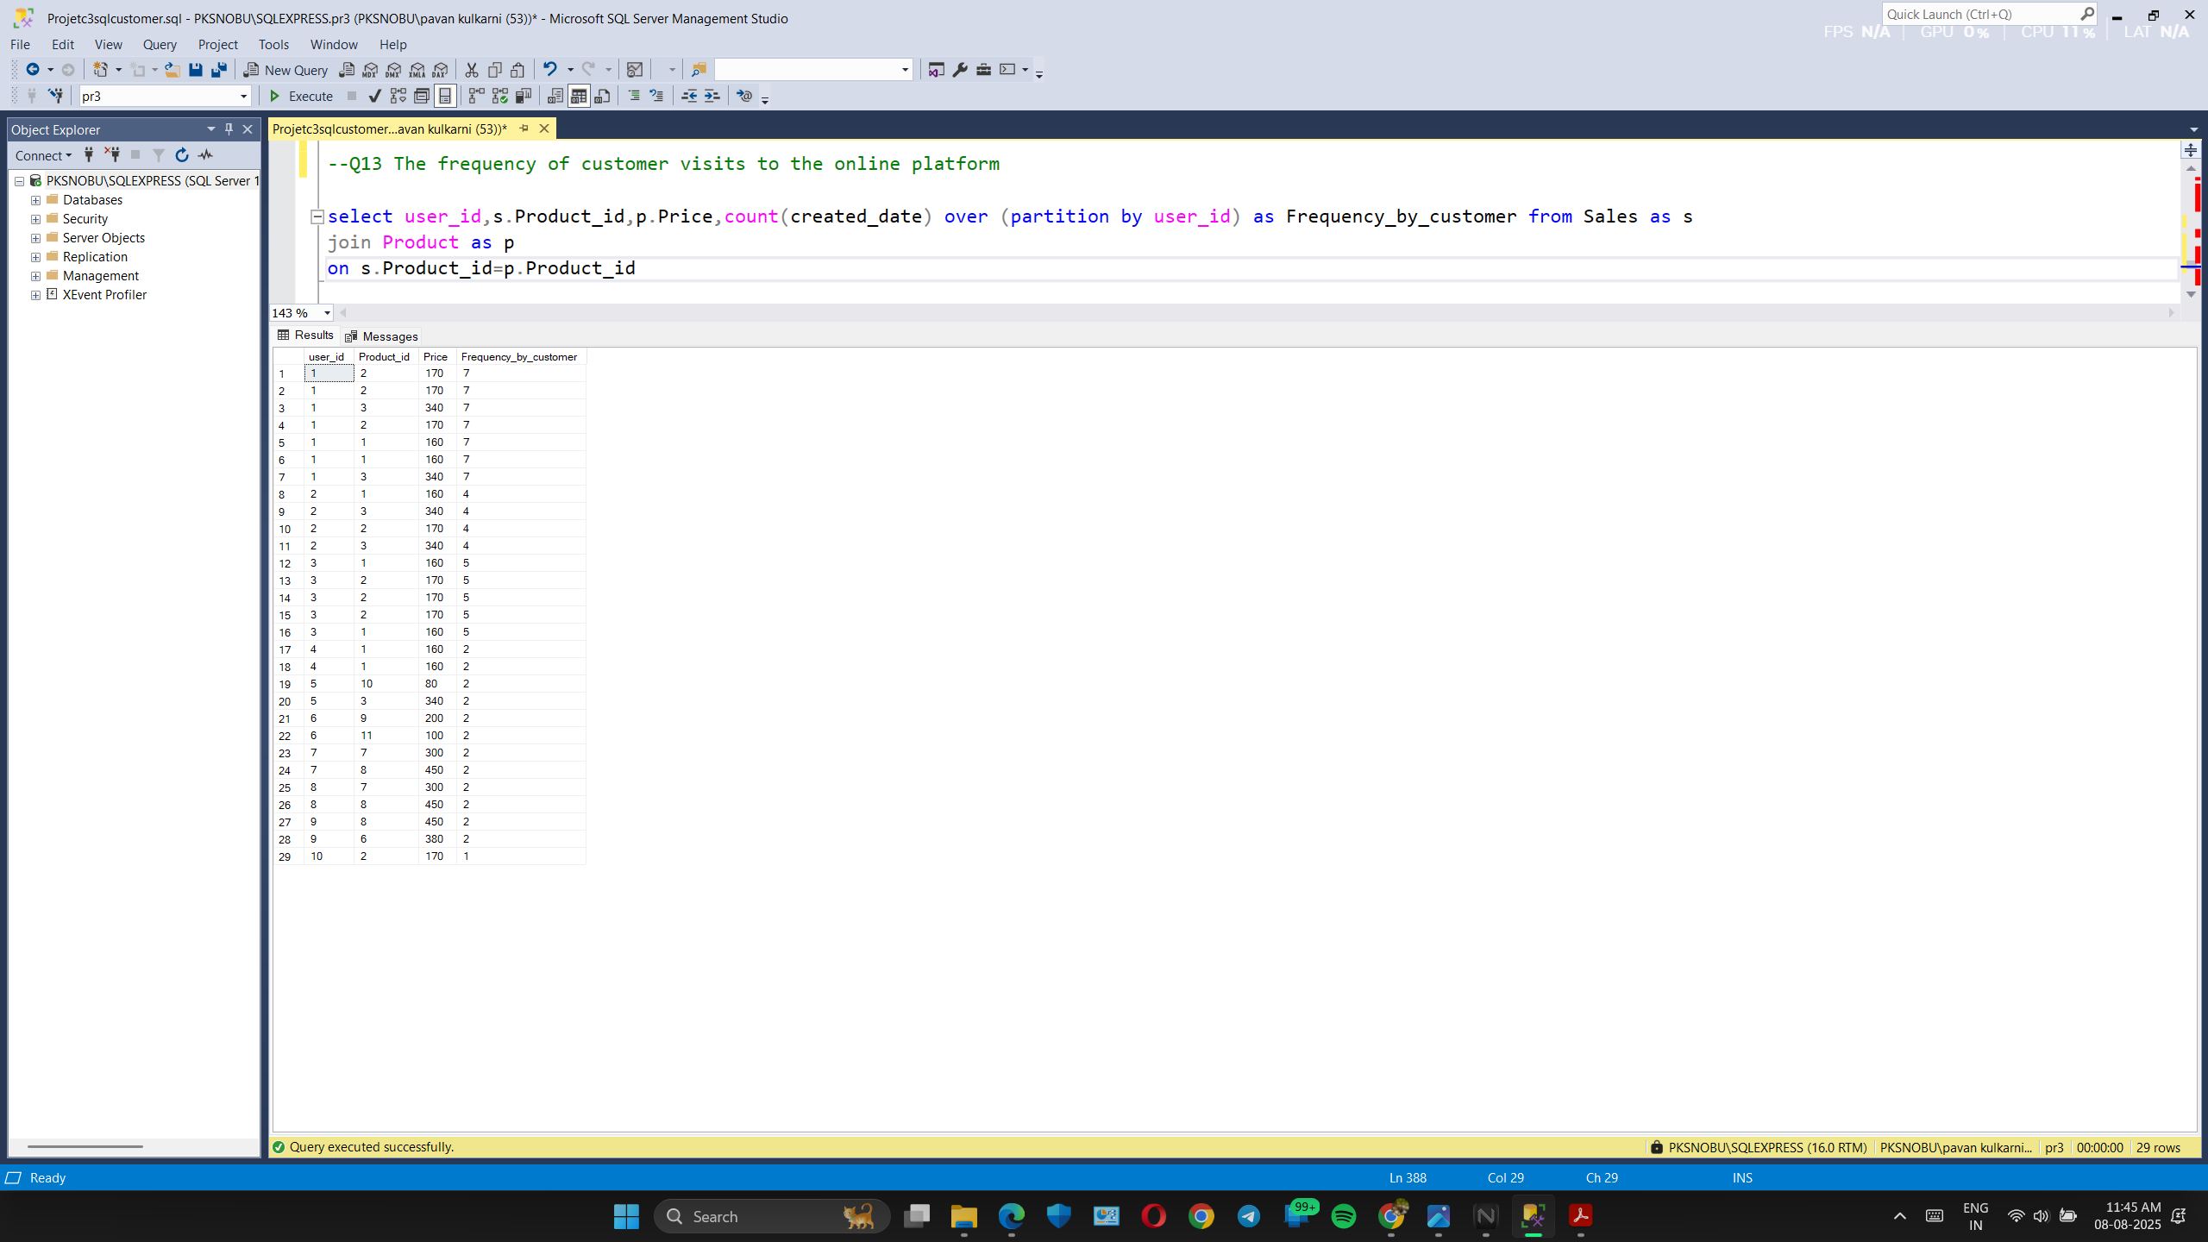
Number of orders by each customer

Slide 16
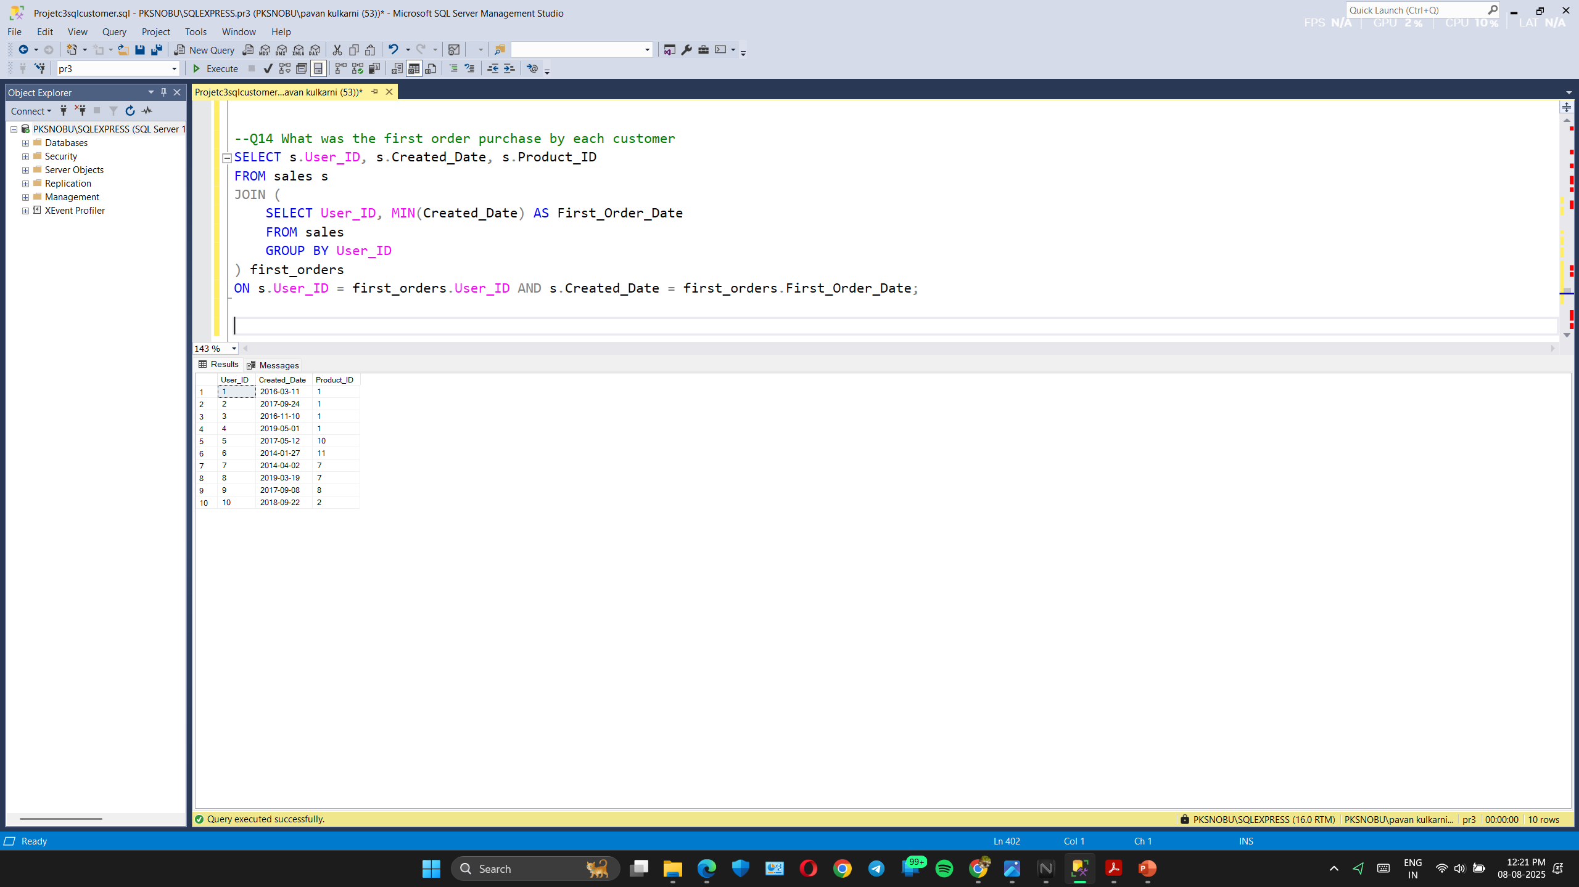
First order date and product by each customer

Slide 17
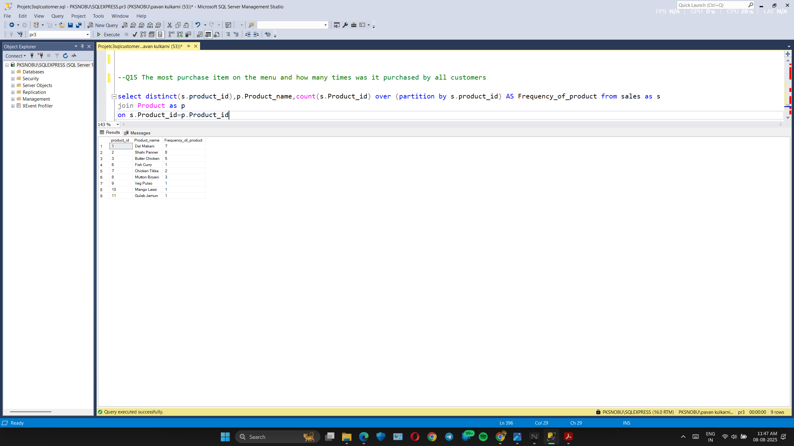
Frequency of product that been ordered

Slide 18
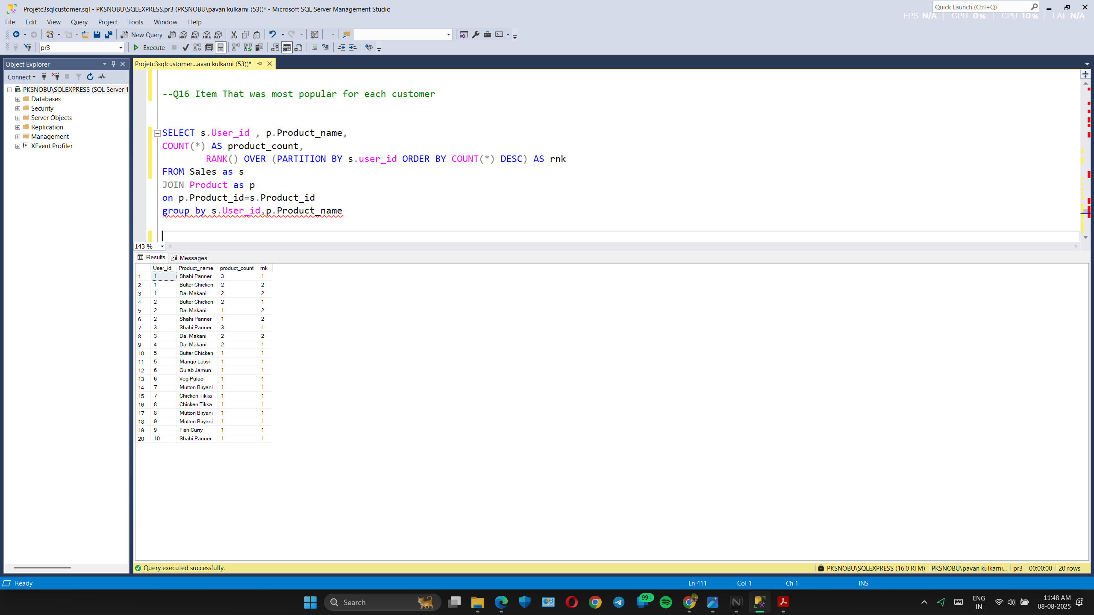
Ranking product that has been ordered by customer

Slide 19
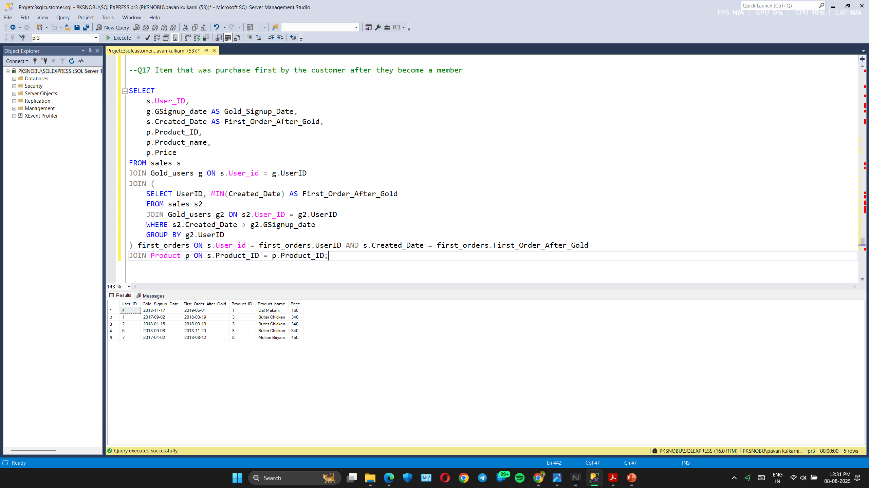
First order after becoming gold members

Slide 20
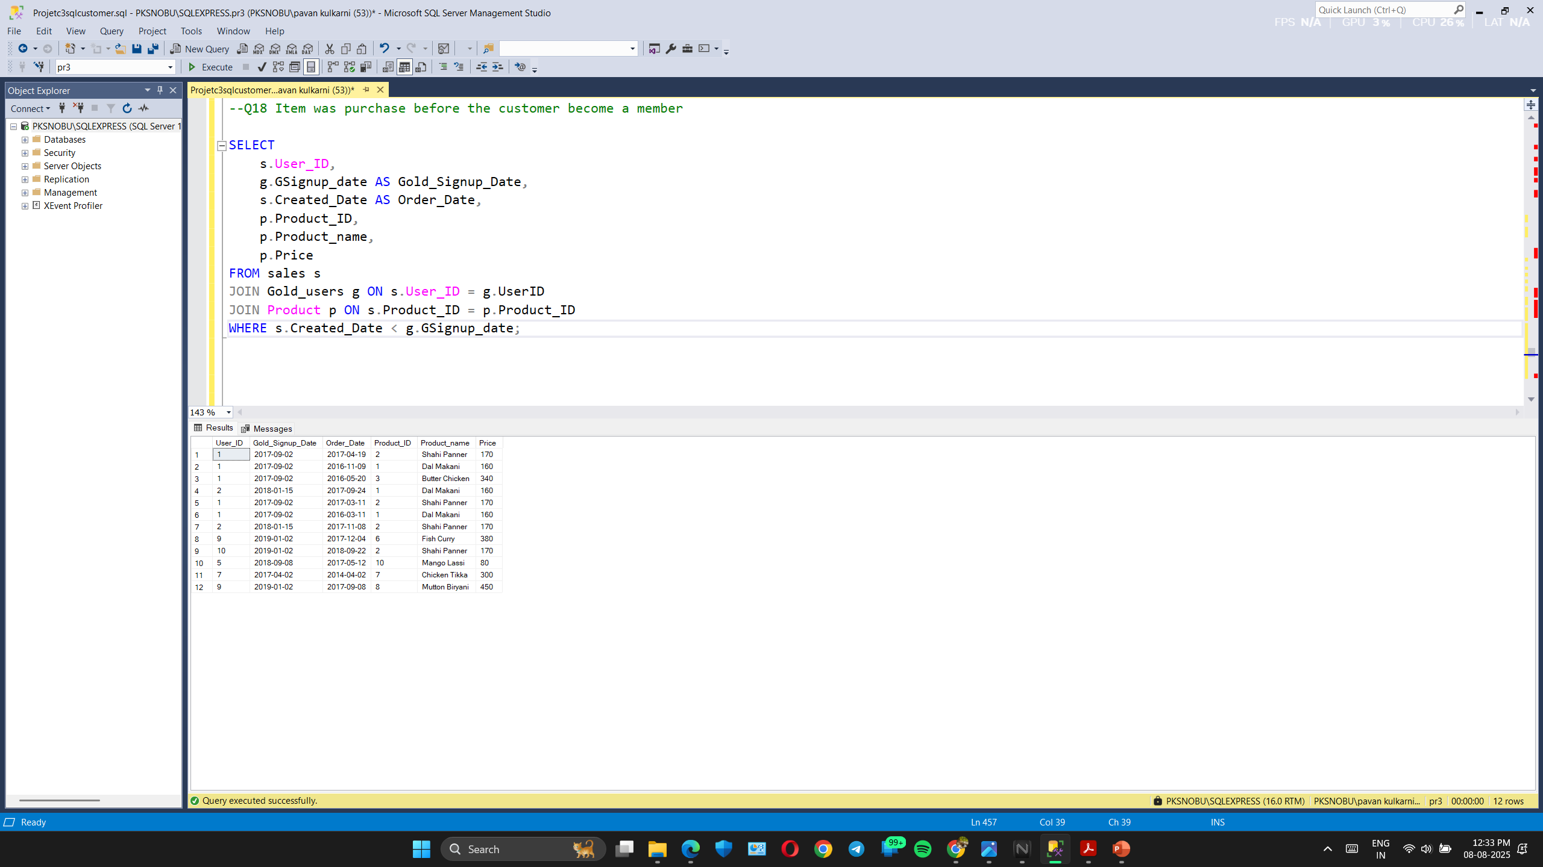
Orders before becoming gold member

Slide 21
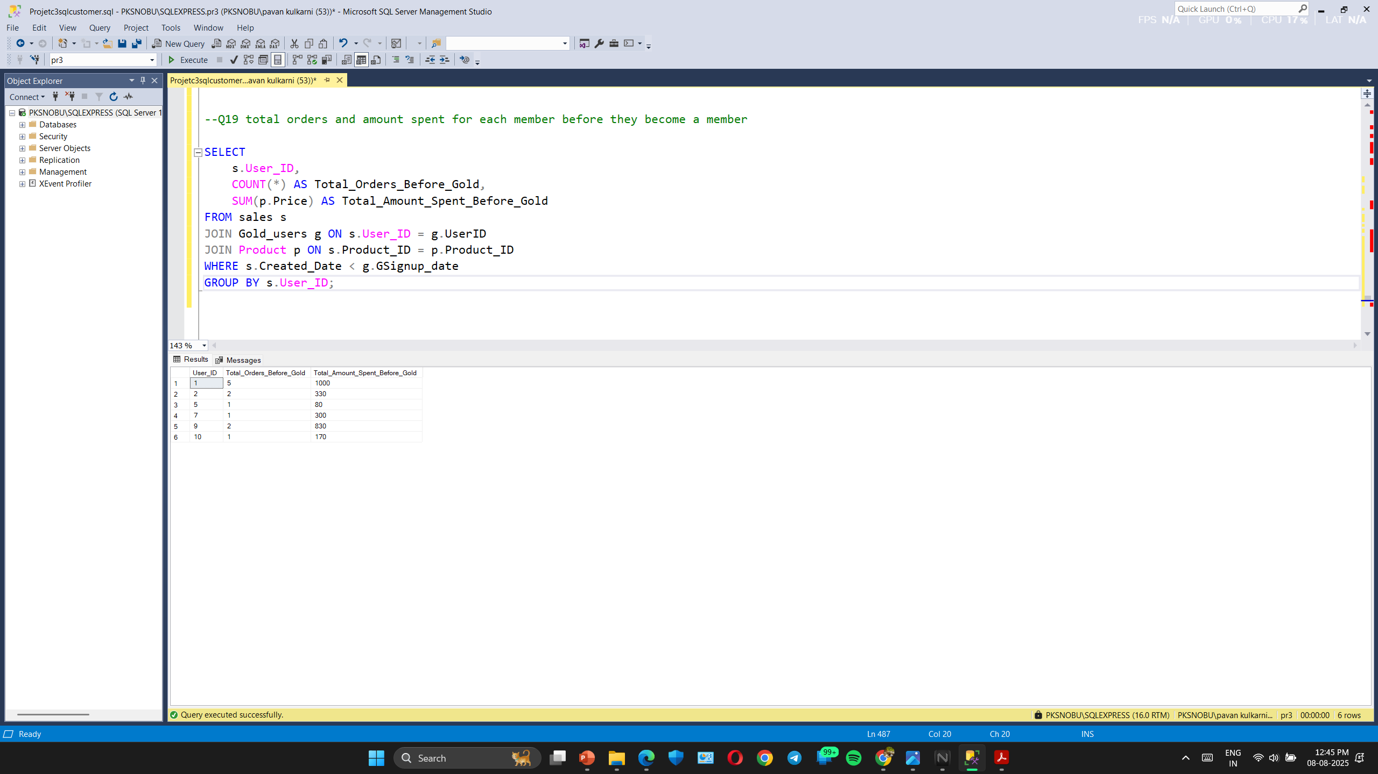
Net-revenue of customer before becoming gold member

Slide 22
This SQL case study successfully revealed meaningful patterns in customer food ordering behavior. By querying the database and analyzing customer trends over time, this project demonstrates how structured data and SQL techniques can support customer retention strategies, marketing efforts, and revenue growth.

